Slide 1
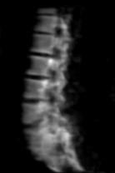
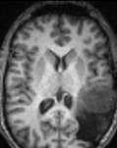
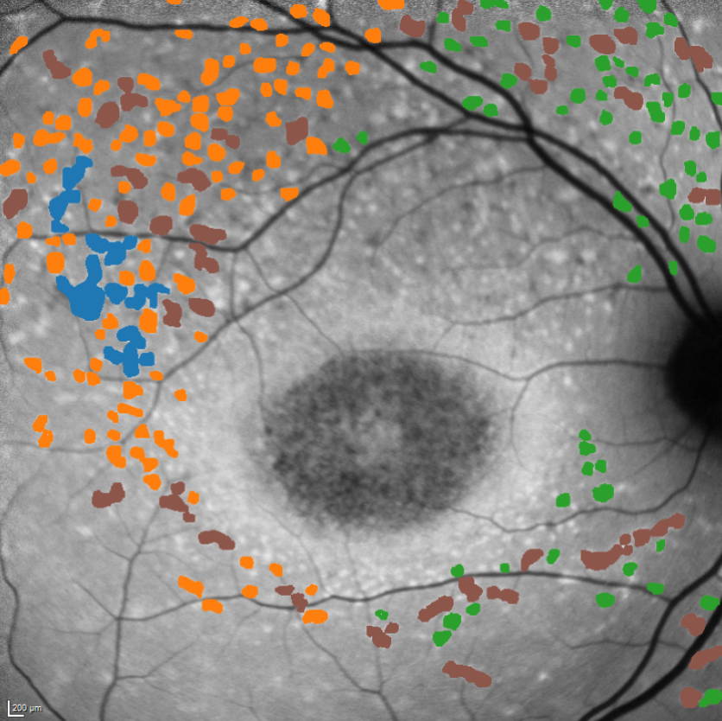
Medical Data Manipulation and Preprocessing
SPARK March 29, 2025
Craig Jones, PhD

Slide 2



Background
BSc (Hons) in Computing Science and Mathematics (Simon Fraser University)
MSc in Medical Biophysics (University of Western Ontario)
PhD in Physics (Medical Biophysics University of British Columbia)

Slide 3
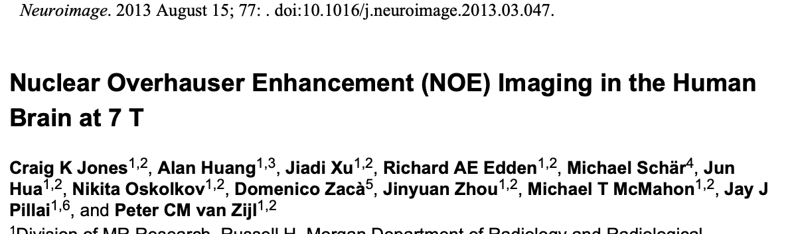
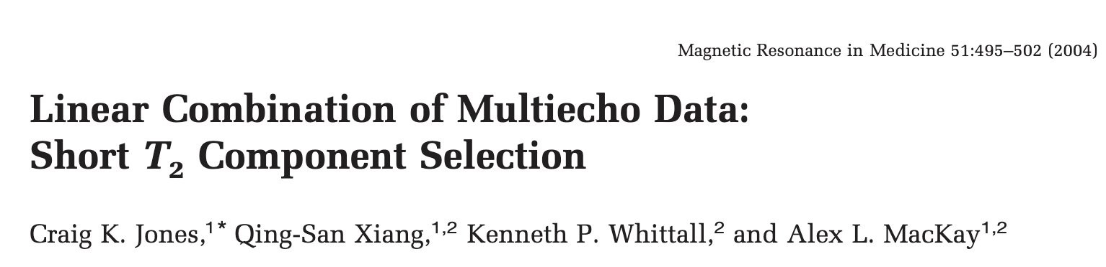
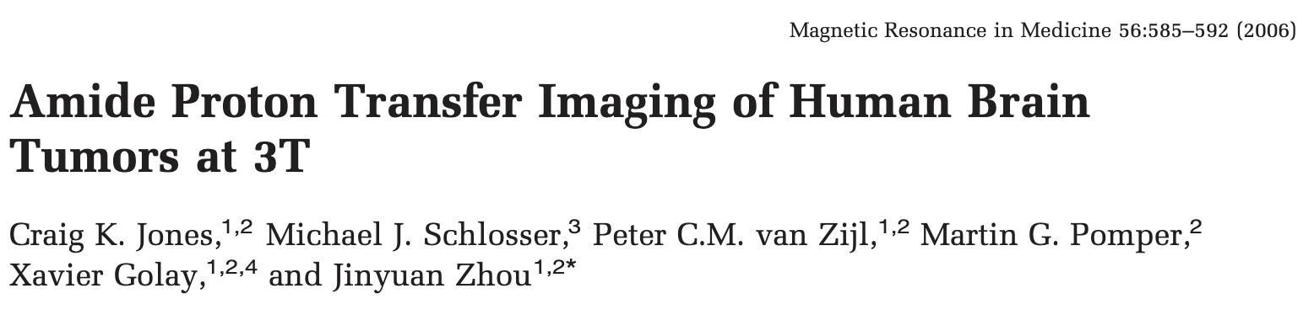
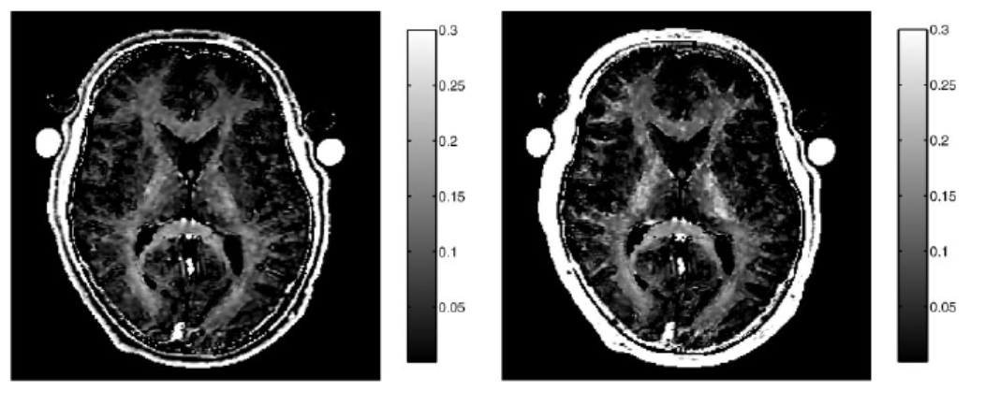
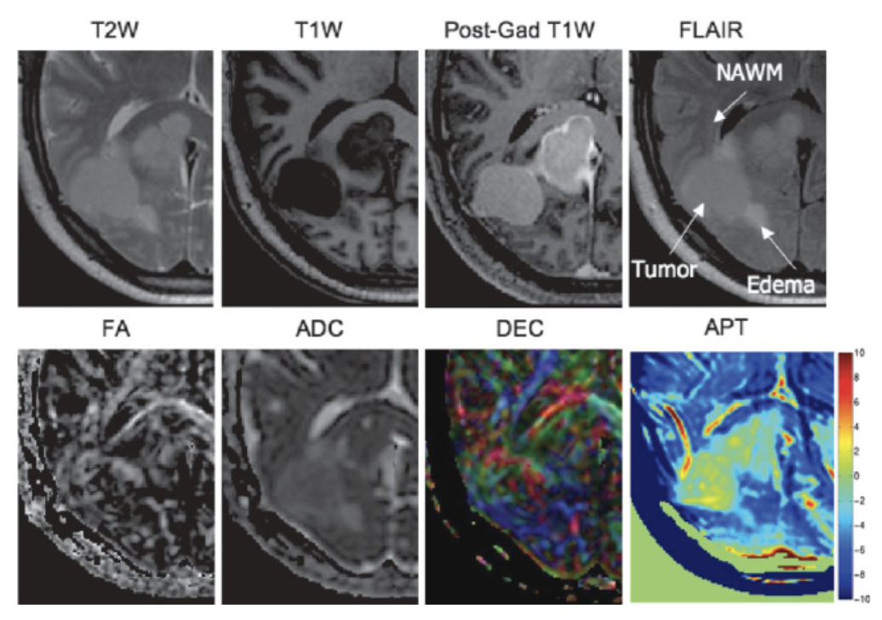
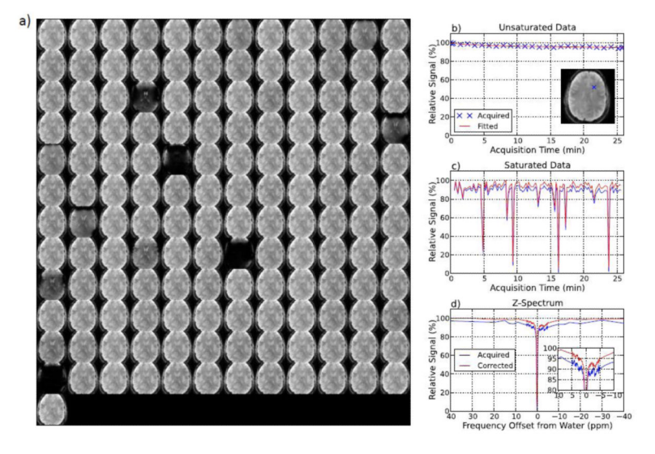
Background
25+ years in medical imaging (magnetic resonance imaging)

Slide 4
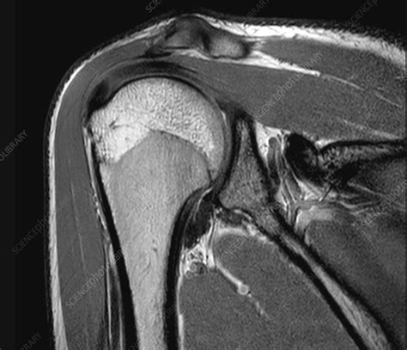
Medical Image Processing
Regions of the Body
Images
File Formats
Processing Software
Signal, Noise, and Artifact
Signal Scaling
Segmentation
Registration / Alignment
Data Augmentation (PyTorch)

Slide 5
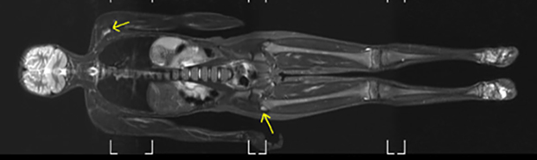
Regions of the Body

Slide 6
What regions of the body need to be imaged?

Slide 7
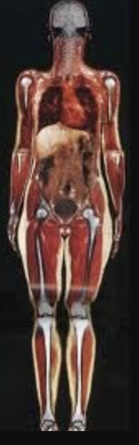
Body Regions
Brain / head
Neck
Shoulder
Heart
Abdomen
Pelvis
Extremities

Slide 8
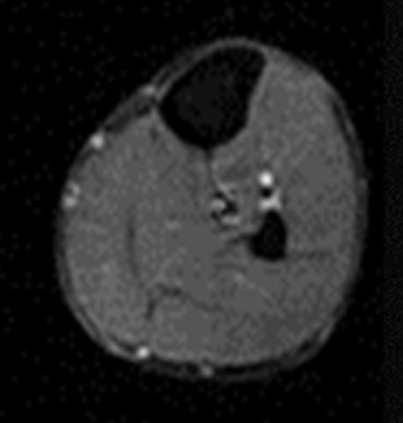
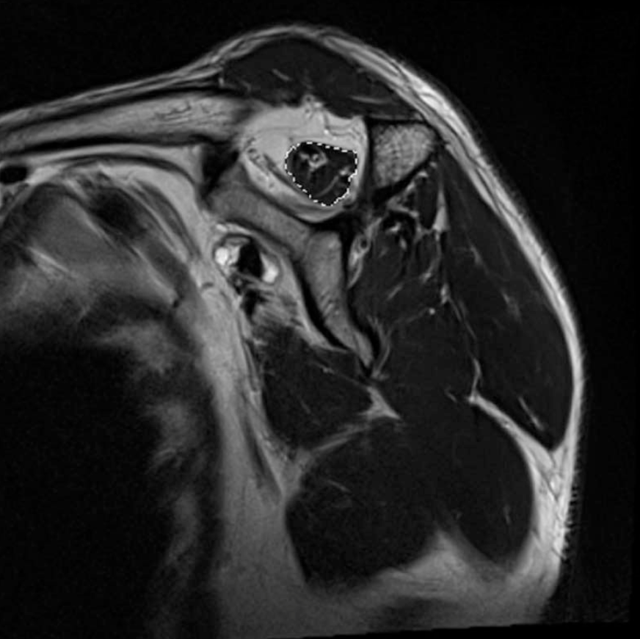
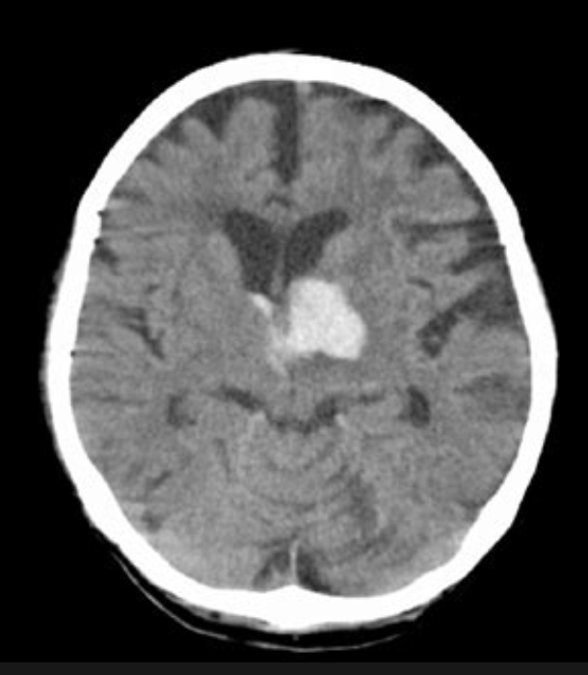
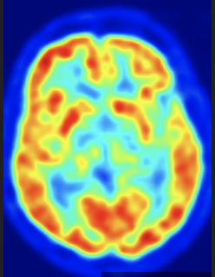
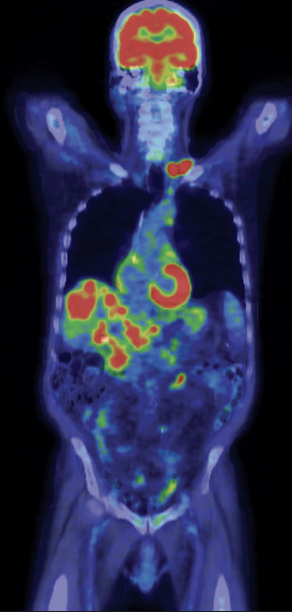
Soft Tissue, Hard Tissue, Metabolism
Soft Tissue in the body (structure)
Brain
Muscle
Tendons
Hard Tissue / Density (structure)
Bone
Tumor
Blood
Metabolism (function)
Glucose uptake
Hyper-polarized
Tumor uptake

Slide 9
Images

Slide 10
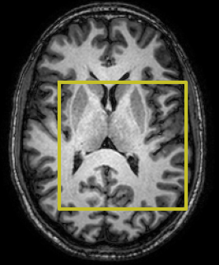
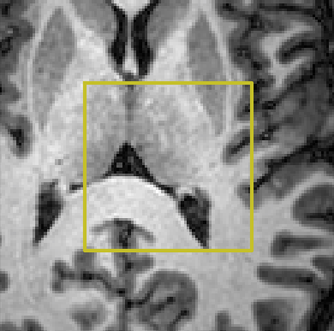
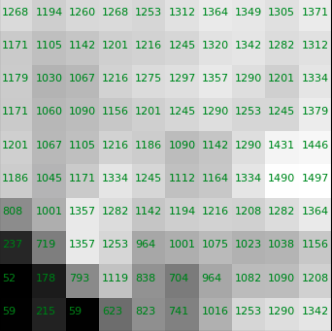
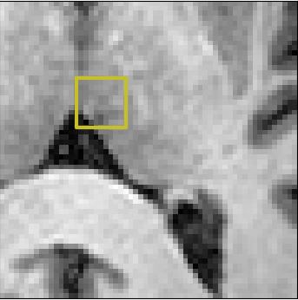
Interpretation of Numbers

Slide 11
What is an image?
Images are made up of pixels (picture element) or voxels (volume element)
Numbers in images may represent a physical unit or a relative value
CT images are in Hounsfield units (typically -500 – 3000)
MRI images are relative signal units (typically 0 – 2500)
absorption of high energy electromagnetic radiation from an x-ray tube in a patient
Human eye can distinguish approximately 100 shades of gray
Pixel

Slide 12
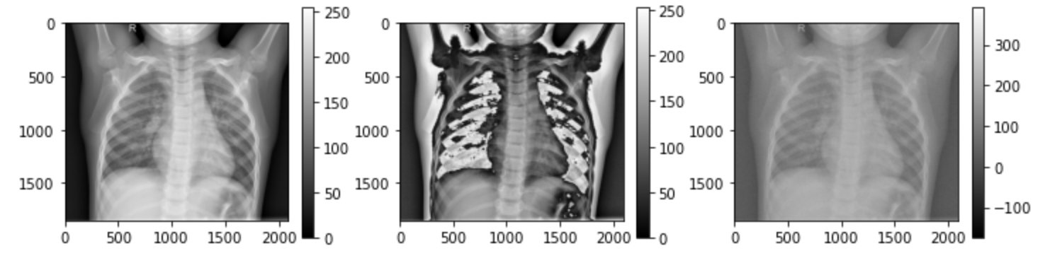
Image Manipulation
All standard image manipulations can be done e.g., addition, subtraction etc.
X-Ray Image
2 * X-Ray Image
Random + X-Ray Image

Slide 13
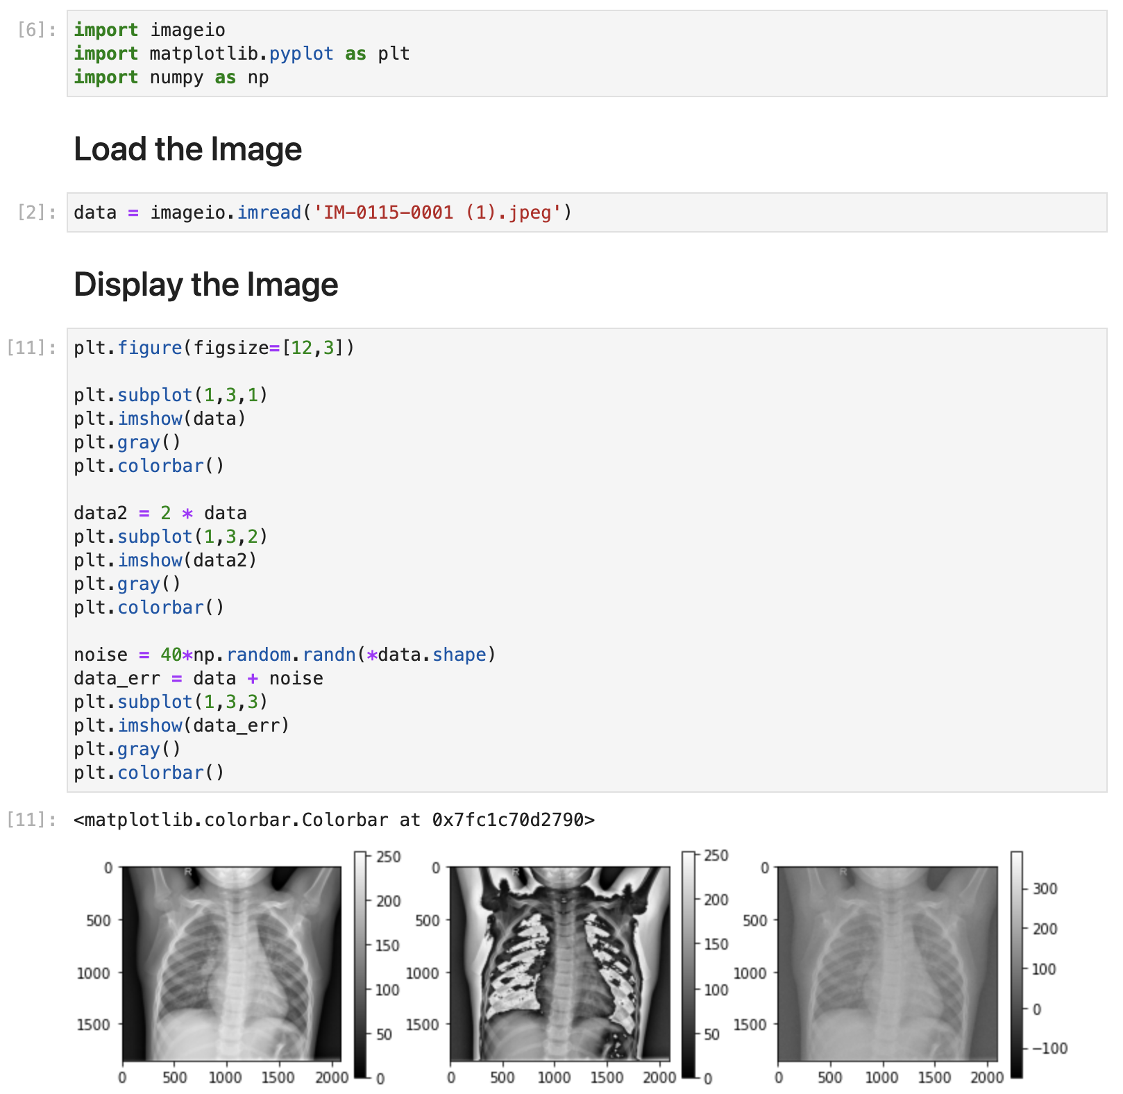

Slide 14
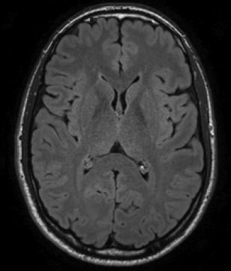
2D vs 3D vs 4D
What is the difference between a 2D dataset and a 3D dataset?

Slide 15
2D vs 3D vs 4D
2D images are typically a single image
May depend on acquisition type
3D images
3 spatial directions, typically rows by columns by slices
4D
3 spatial directions and a time direction
Example is CT perfusion data or fMRI data

Slide 16
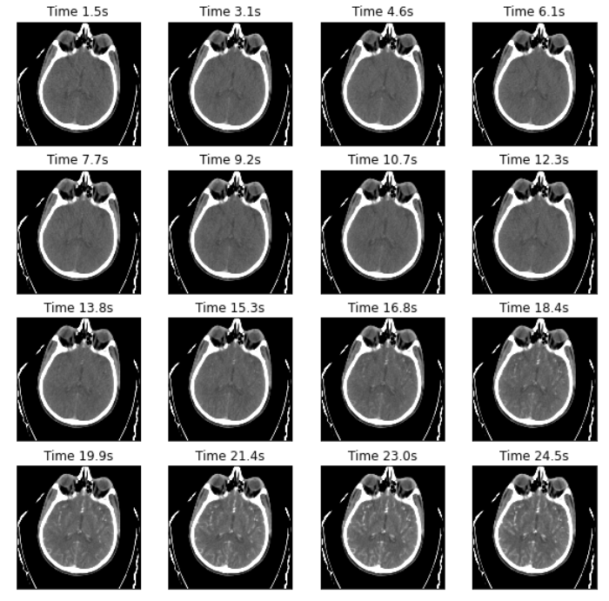
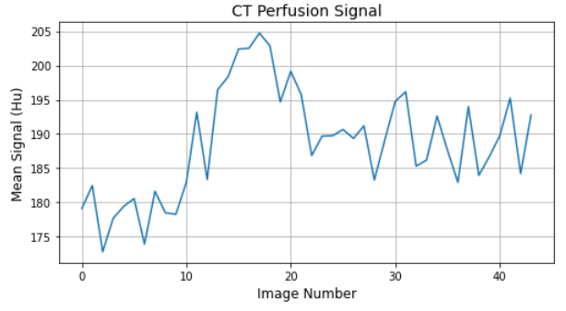
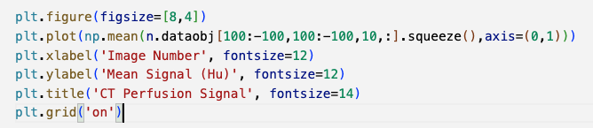
Spatial vs Time Scans: CT Perfusion

Slide 17
Pixel vs Voxel Dimension
In-plane pixel size is measured in millimeters
CT is typically 0.5 mm x 0.5 mm
MRI is typically 3 mm x 3 mm
All images have a thickness, typically in millimeters as well
Image thicknesses is typically larger than the in-place thickness
Some acquisitions might also have a “gap” between the images

Slide 18
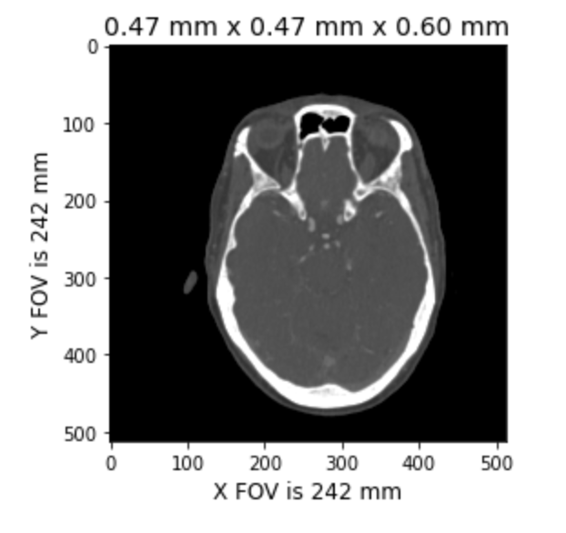
Image Field of View
Image field-of-view is the width and length of the image in real-world units (e.g., microns or millimeters)

Slide 19
Gray Scale Images vs Color Images
Gray scale image is a single channel (rows by columns)
Color images are 3-channel
Typically red, green, blue channels
To make a gray scale image using 3-channels, copy the same value to all 3 channels

Slide 20
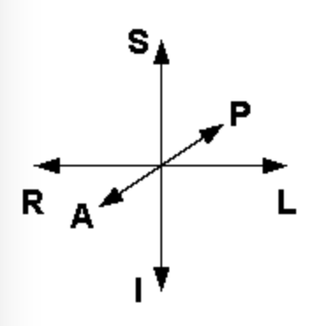
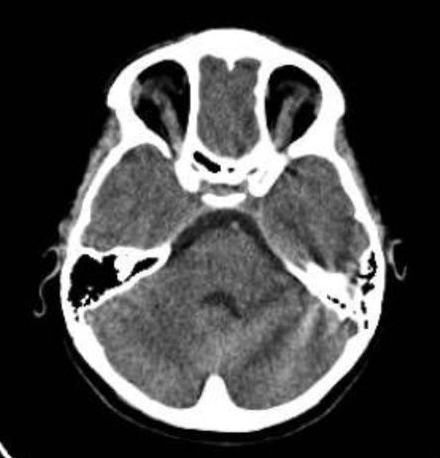
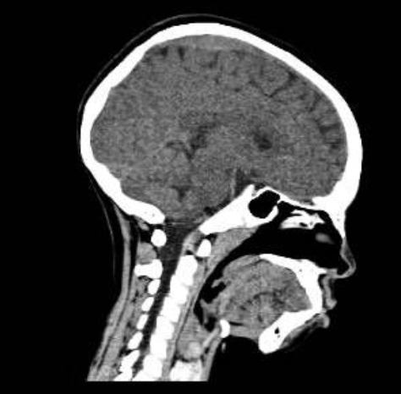
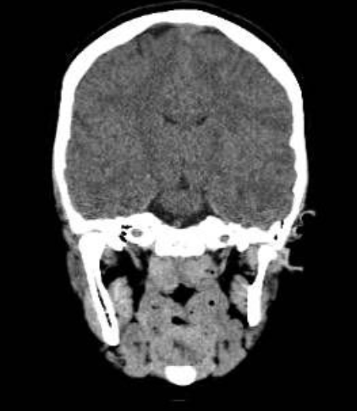
Orientation of Images
Radiology convention is patient left on right side, patient right on left side of image
A
S
S
R
L
P
A
R
L
P
I
I

Slide 21
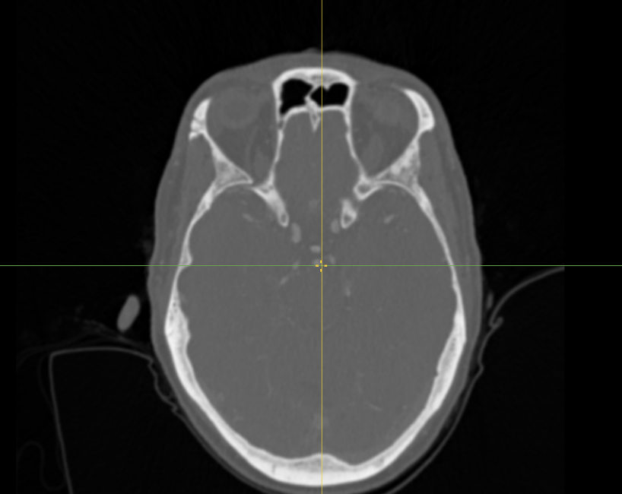
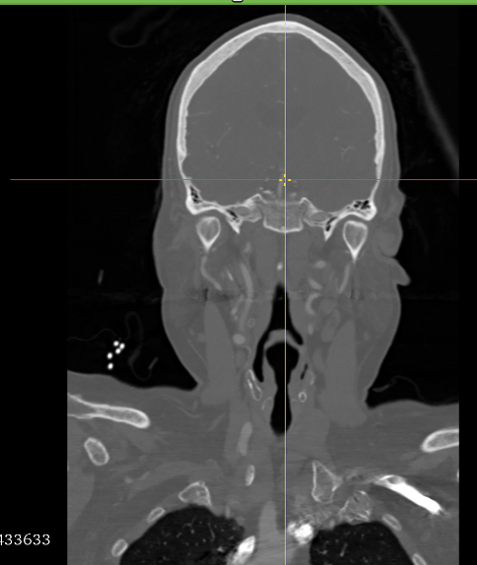
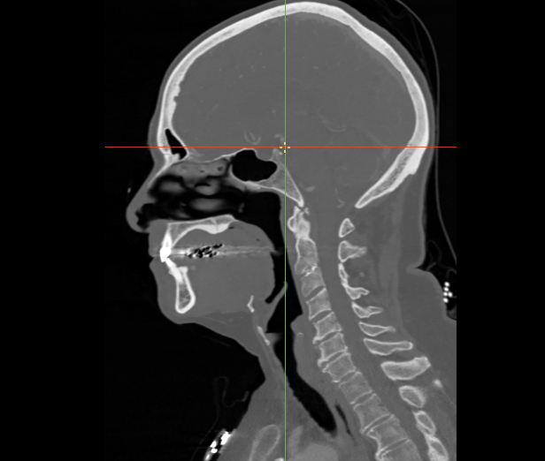
Axial Sagittal Coronal
Axial
Sagittal
Coronal

Slide 22
Medical Imaging File Formats

Slide 23
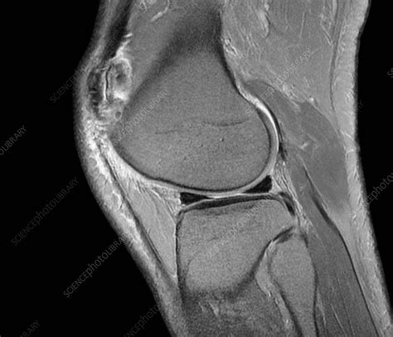
Medical Imaging File Formats
What needs to be stored in a medical image?

Slide 24
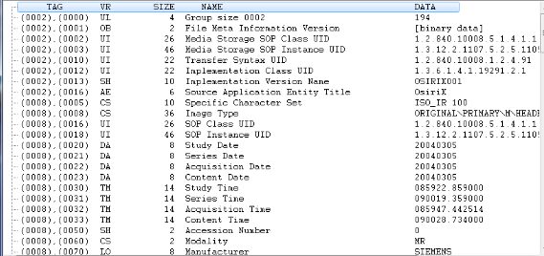
Various Imaging File Formats
JPEG / PNG / TIFF (not a medical imaging file format)
DICOM
NIFTI
MHA
MINC

Slide 25
JPEG / PNG / TIFF
JPEG image files
Most common file format available, digital photography
Lossy or lossless compression
Up to 10:1 compression
PNG
Raster file format
Supports lossless compression
Transparency
… and Others
GIF, BMP

Slide 26
JPEG / PNG
Why are JPEG and PNG not good file formats to use for medical imaging?

Slide 27
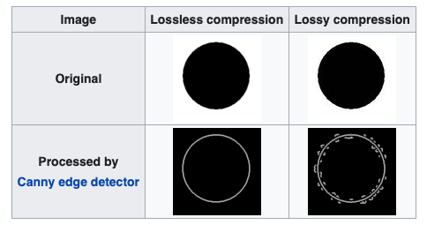
JPEG / PNG / TIFF
No header
Missing context about the image
Missing scan information
No voxel size or FOV information
Data is scaled to be 0 to 255
… well, not necessarily for TIFF
https://en.wikipedia.org/wiki/JPEG
Best to use other file formats for medical image processing.

Slide 28
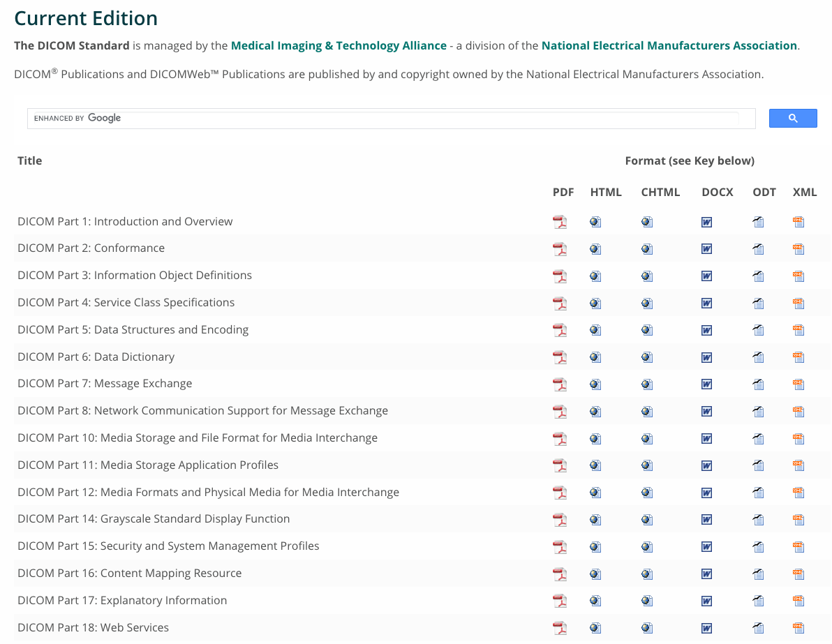
DICOM
Medical imaging standard (Medical Imaging & Technology Alliance)
Includes file format AND data exchange
“Part 5” alone is 154 pages of night time reading

Slide 29
DICOM Image File Format
DICOM stores 1 image per file
3D and 4D datasets are stored in a directory and can have 100s of files
Filenames are stored with a UID
Four levels of hierarchy
Patient
Information about the person
Study
Information about “today’s scan”
Series
A series is a single scan method (e.g., diffusion MRI scan)
Instance
The slice information
https://towardsdatascience.com/understanding-dicom-bce665e62b72

Slide 30
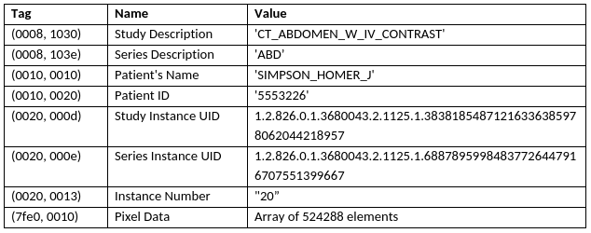
DICOM Image File Format
A field in the header has three parts:
Tag (a tuple of two values)
Name
Value
https://towardsdatascience.com/understanding-dicom-bce665e62b72

Slide 31
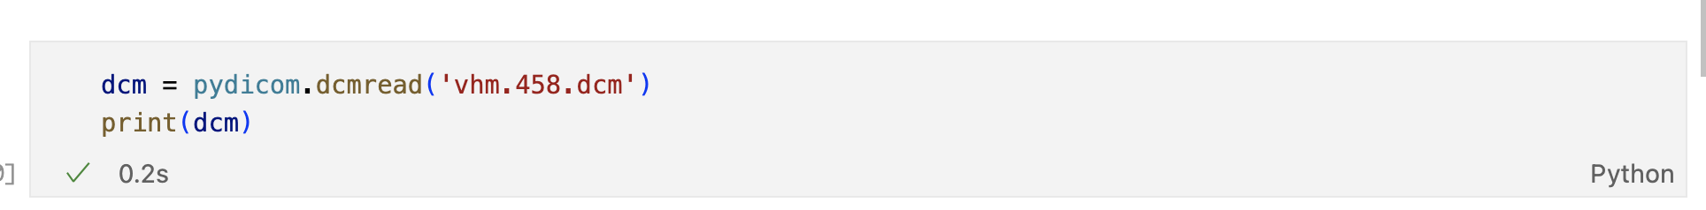
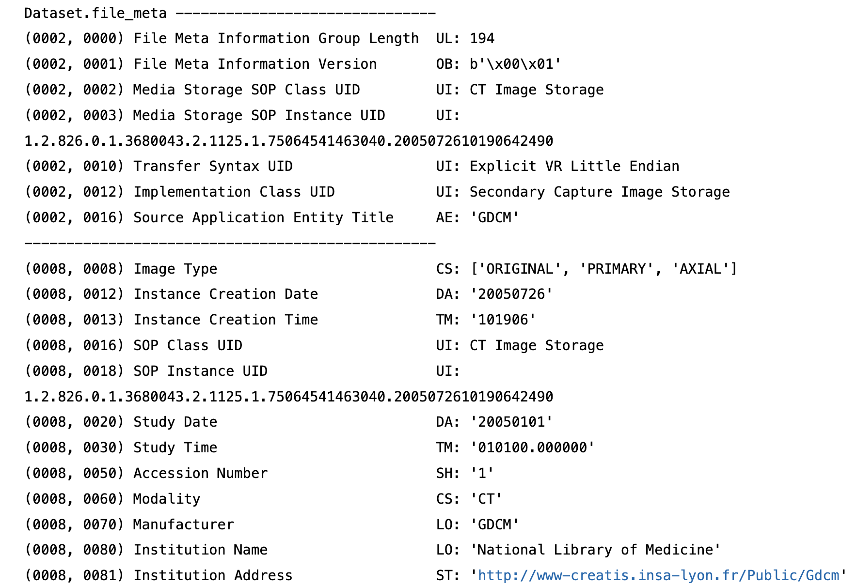
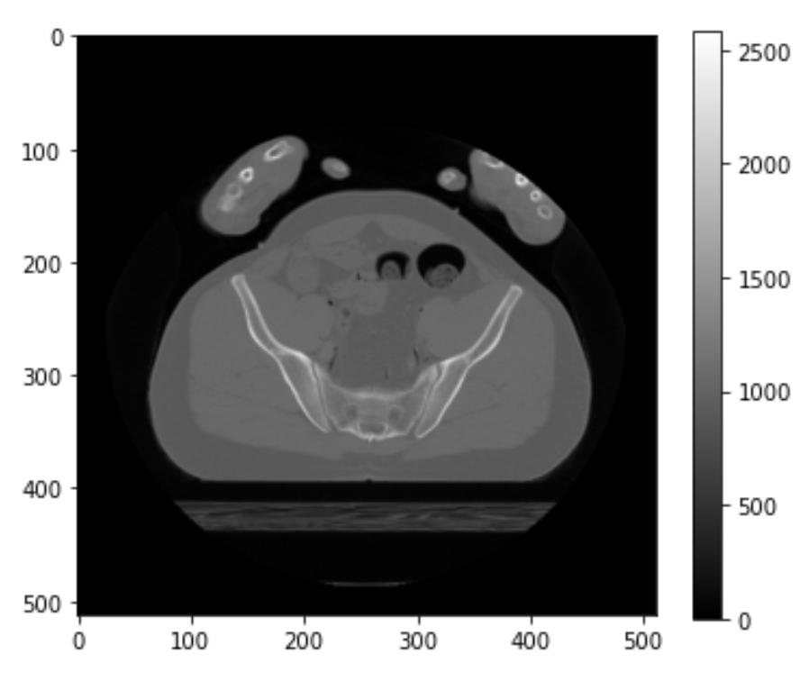
DICOM Example

Slide 32
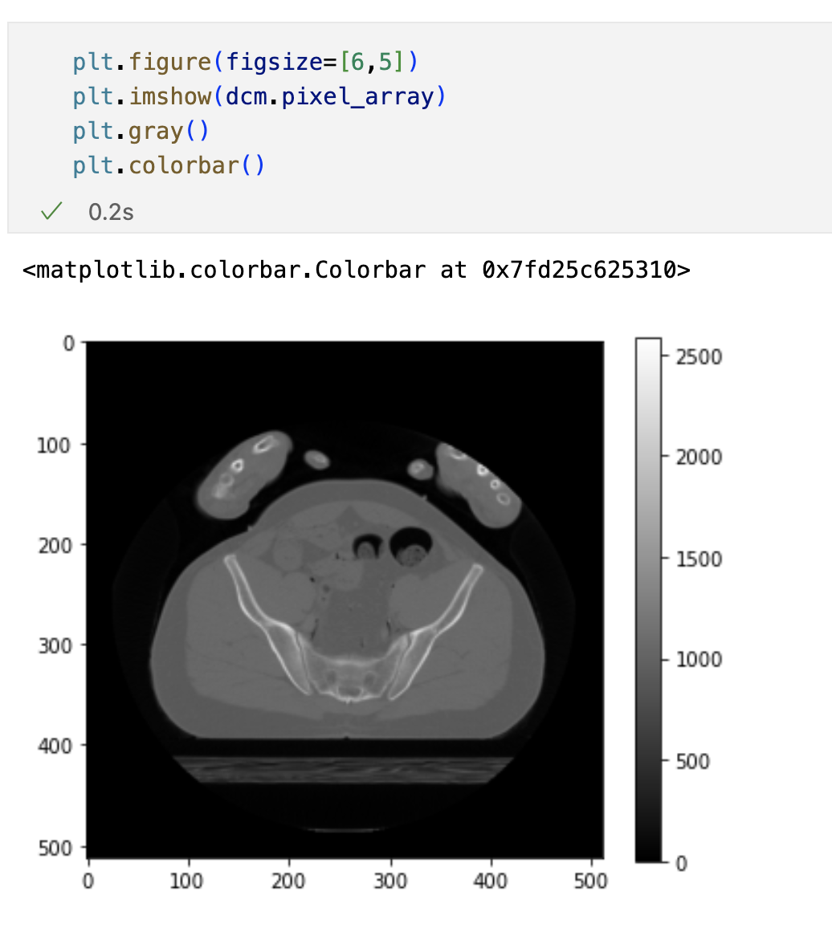
DICOM Example
Data is stored in the attribute “pixel_array”
E.g.,
dcm.pixel_array

Slide 33
NIFTI (and Analyze)
Started out as “Analyze” file format
.hdr and .img files separate
NIFTI format
Header and data in one file (“.nii” or “.nii.gz”)
348 byte header
4+ dimensions of data can be stored (including pixel “size”)
Complete set of data types (8 bit to 128 bit)
Affine coordinate definitions relating voxel index to real world spatial index
https://nifti.nimh.nih.gov/nifti-1

Slide 34
…And Others
MHA
Associated with ITK
Stores information when processed (e.g., registration or segmentation) through ITK
Use “pip install medpy” to read MHA files in Python
MINC
Medical Image NetCDF out of McGill
“.mnc”
https://www.mcgill.ca/bic/software/minc
AFNI
“.brik” file format used primarily with AFNI software

Slide 35
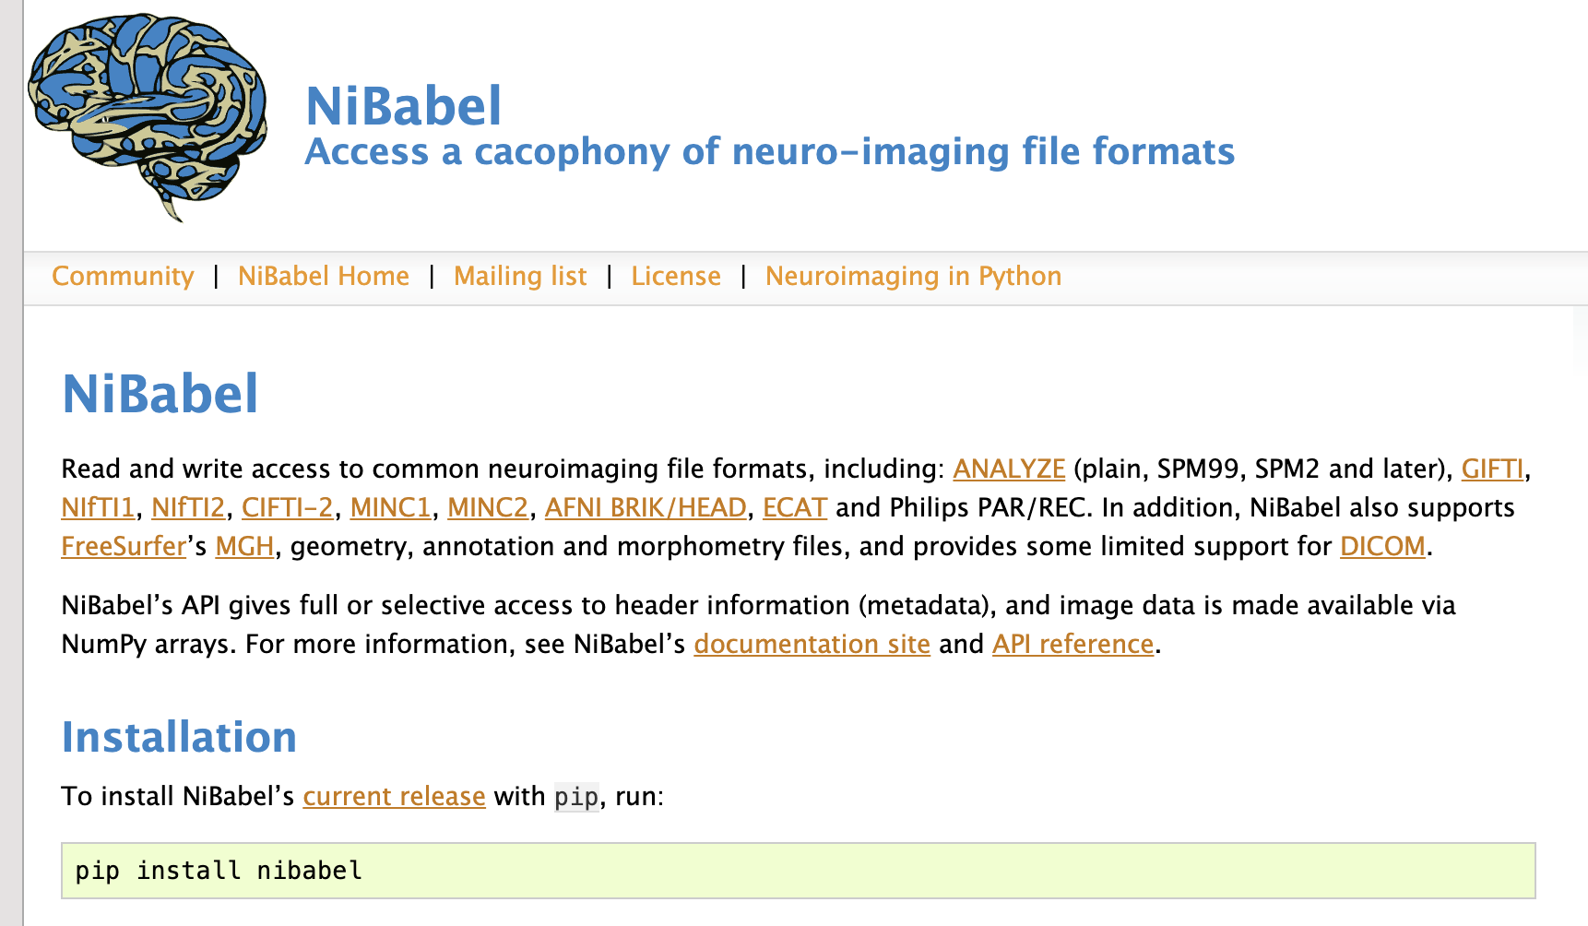
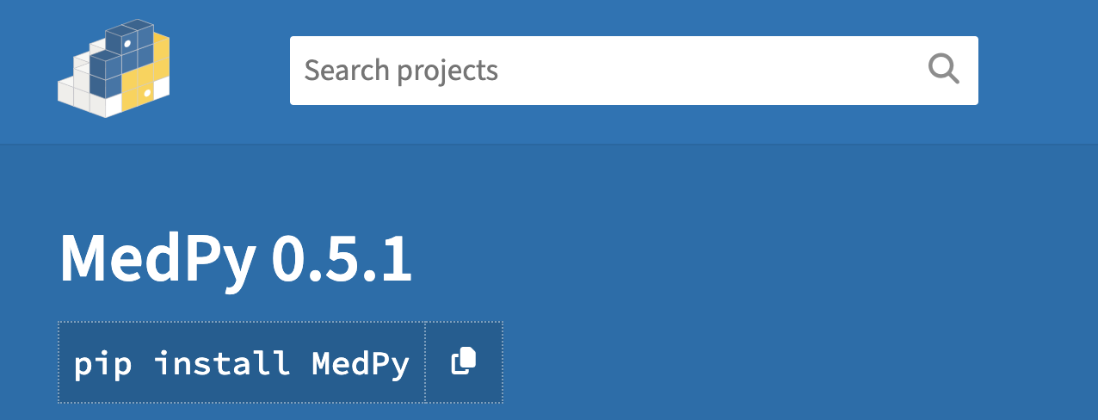

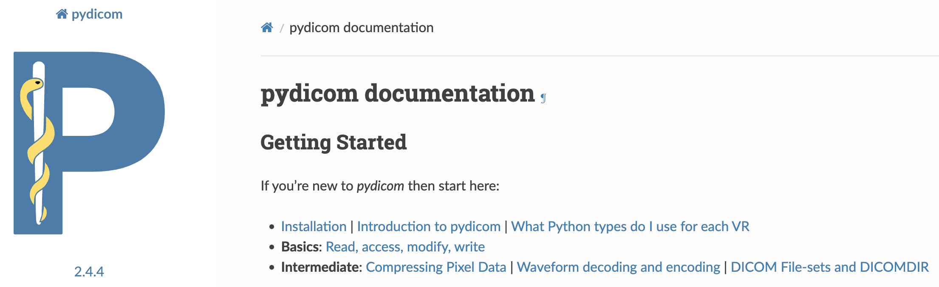
Python Software

Slide 36
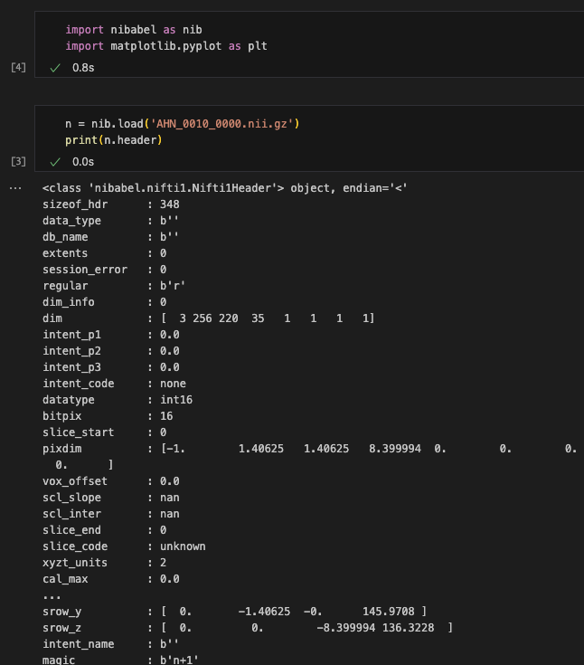
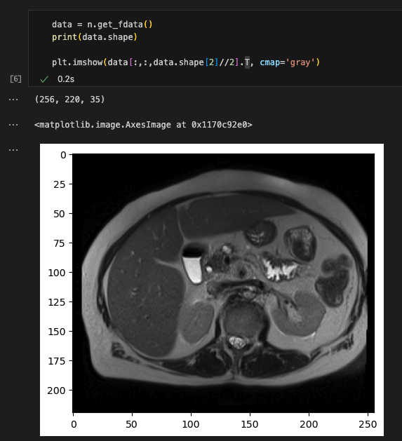
In Python…

Slide 37
Saving NIFTI Data in Python
Three things needed when saving:
Data
Affine matrix
Header
Affine matrix defines the mm to pixel scale and orientation
# Get the real, corrrect affine matrix from the PVP NIFTI filen = nib.load('filename_pvp_nifti_from_dicom.nii.gz’)
data = n.get_fdata()
# Save the data with the correct affine matrix as a NIFTI file.
new_nifti_data = nib.Nifti2Image(data,
affine=n.affine,
header=n.header)
new_nifit_data.save()

Slide 38
Medical Image Processing Software

Slide 39
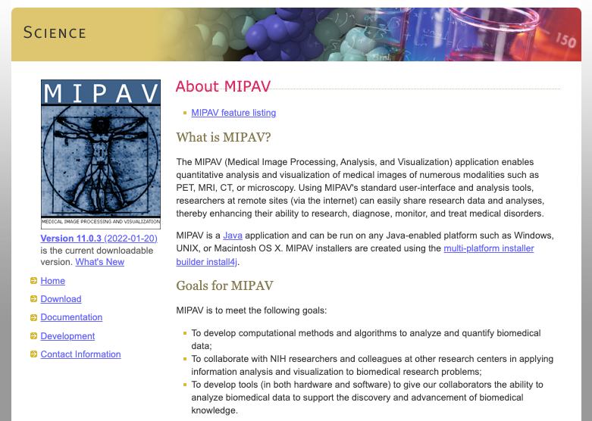
MIPAV
MIPAV is a free visualization tool
https://mipav.cit.nih.gov

Slide 40

ImageJ/FIJI
Free Java based visualization and quantitative processing software
https://imagej.net/software/fiji/

Slide 41

MITK
Free visualization software based on ITK (Insight Toolkit)
https://www.mitk.org/wiki/The_Medical_Imaging_Interaction_Toolkit_(MITK)

Slide 42

3D Slicer
Free software for medical image visualization and processing
Python API to extend the features
https://www.slicer.org

Slide 43
…and Others
BrainVoyager
http://www.brainvoyager.com/
FSL
https://fsl.fmrib.ox.ac.uk/fsl/fslwiki/
Good image registration program
SPM
https://www.fil.ion.ucl.ac.uk/spm/
AFNI
https://afni.nimh.nih.gov

Slide 44
Signal…

Slide 45

What is Signal?

Slide 46



Signal
Signal is the average pixel intensity in a region
where I(x,y) is the signal intensity at (x,y)
White matter mean signal is 763.6
… or …
$μ_{WM}=763.6$
$S_{WM}=763.6$
(Not 763.6476475675677, why?)
$$μ_{WM}= \frac{1}{N}\sum_{Region}{I(x,y)}$$

Slide 47

Noise vs Artifact
Noise
contributions to a measured signal due to random processes
contributions are of statistical nature and do not carry any information about the signal
Artifact
part of the contents of an image that does not have a counterpart in the physical object being imaged; an artifact can appear as false structures
"Computed Tomography" by Willi A. Kalender, 2011

Slide 48
Estimating Noise in an Image II
What contributes to the standard deviation of the signal in a region?
Noise in acquisition of the image
Artifacts in the image
Tissue heterogeneity

Slide 49
Signal to Noise Ratio
Can we calculate an SNR in the tissue?
Well, it is difficult…

Slide 50
Signal Scaling

Slide 51

Signal Range
np.min(image) = -1024.0
np.max(image) = 1245.0
What is the range of signal in the image?

Slide 52
Histogram

Slide 53


Signal Scaled – Min/Max to 0/1
$$S_{norm}= \frac{(S −\min\left(S\right))}{\left(\max\left(S\right)−min⁡(S)\right)}$$

Slide 54




Signal Normalization vs Standardization
$$S_{norm}= \frac{(S −\min\left(S\right))}{\left(\max\left(S\right)−min⁡(S)\right)}$$
$$S_{perc}= \frac{(S −P_{0.1}\left(S\right))}{\left(P_{99.9}\left(S\right)−P_{0.1}⁡(S)\right)}$$
$$S_{standardized}= \frac{(S −\operatorname{mean}\left(S\right))}{std(S)}$$
dd_norm = (dd - np.min(dd)) / (np.max(dd) - np.min(dd))
dd_perc = np.clip((dd - np.percentile(dd, 0.1)) /
(np.percentile(dd, 99.9) - np.percentile(dd, 0.1)), 0, 1)
dd_std = (dd - np.mean(dd)) / np.std(dd)

Slide 55



Signal Normalization vs Standardization
S_norm = (dd - np.min(S)) / (np.max(S) - np.min(S))
S_perc = np.clip((S - np.percentile(S, 0.1)) /
(np.percentile(S, 99.9) –
np.percentile(S, 0.1)), 0, 1)
S_std = (S - np.mean(S)) / np.std(S)
$$S_{norm}= \frac{(S −\min\left(S\right))}{\left(\max\left(S\right)−min⁡(S)\right)}$$
$$S_{perc}= \frac{(S −P_{0.1}\left(S\right))}{\left(P_{99.9}\left(S\right)−P_{0.1}⁡(S)\right)}$$
$$S_{standardized}= \frac{(S −\operatorname{mean}\left(S\right))}{std(S)}$$

Slide 56
Segmentation

Slide 57

What is Segmentation?

Slide 58
What is Segmentation?
the process of partitioning a digital image into multiple image segments, also known as image regions or image objects (sets of pixels)
https://en.wikipedia.org/wiki/Image_segmentation

Slide 59
Segmentation Categories

Slide 60

Segmentation Categories
Hard Segmentation
Mask is binary (assuming two classes, background and lesion)
Fuzzy Segmentation
Mask is floating point (typically range from 0 and 1)
Each pixel is weighted by inclusion

Slide 61


Segmentation Categories
Hard Segmentation
Mask is binary (assuming two classes, background and lesion)
Fuzzy Segmentation
Mask is floating point (typically range from 0 and 1)
Each pixel is weighted by inclusion

Slide 62


Hard Segmentation
Semantic segmentation: for every pixel, belonging class of the object

Slide 63

Hard Segmentation
Instance segmentation: for every pixel, belonging class of the object
scipy.ndimage.label()

Slide 64
Threshold Based Segmentation

Slide 65


Threshold Based Segmentation
Histogram of the Image

Slide 66

Histogram Threshold Values

Slide 67

Threshold Segmentation Summary
Pros
One of the simplest methods to segment an image
Easy to choose a threshold value
Segment into numerous regions
Cons
Difficult to adapt to artifacts in the image
All spatial information is lost
For most segmentation, neural networks and deep learning are likely going to be the direction to follow.

Slide 68
Registration / Alignment

Slide 69


What is registration or alignment?

Slide 70


Types of Registration
Rigid Body
Rotations and translations in 3D
6 degrees of freedom
Affine Transformation
Rotations, translations, scale, skew
> 6 degrees of freedom
Deformable Registration
Each voxel can move different amounts and directions
Typically, for medical imaging, |J| < 0 (no “ripping” of the image)

Slide 71



Algorithms for Medical Image Registration
Flirt
Very old, stable code for aligning medical images
https://fsl.fmrib.ox.ac.uk/fsl/fslwiki/FLIRT
Simple call structure, very slow
ANTS Syn
Advanced normalization tools
https://github.com/ANTsX/ANTs
Very complex call structure but fast.
IITK
https://examples.itk.org/src/registration/

Slide 72



ANTS
$ antsRegistrationSyn.sh -d 3 -f $template -m $moving -o output_rigid -t r -p f
Results in:
antsRegistration --verbose 1 --dimensionality 3 --float 1 --collapse-output-transforms 1 --output [ output_rigid,output_rigidWarped.nii.gz,output_rigidInverseWarped.nii.gz ] --interpolation Linear --use-histogram-matching 0 --winsorize-image-intensities [ 0.005,0.995 ] --initial-moving-transform [ tt_BR_T2W_FLAIRSENSE_20091124103934_6.nii.gz,tt_WIPBR_T2W_FLAIRSENSE_20140529105838_6.nii.gz,1 ] --transform Rigid[ 0.1 ] --metric MI[ tt_BR_T2W_FLAIRSENSE_20091124103934_6.nii.gz,tt_WIPBR_T2W_FLAIRSENSE_20140529105838_6.nii.gz,1,32,Regular,0.25 ] --convergence [ 1000x500x250x100,1e-6,10 ] --shrink-factors 8x4x2x1 --smoothing-sigmas 3x2x1x0vox
Template/Static
Moving
Aligned
2009 Scan
2014 Scan
2014 Aligned to 2009

Slide 73
Data and Neural Networks
What is Data Augmentation?

Slide 74
Data and Neural Networks
Load the Training and Validation Data
Setup Data Augmentation
Setup model, loss function and optimizer
Load Batch of Training Data
Evaluate the Model
Training
Compute Training Loss
Data
Augmentation
Run Back Propagation
Epoch Loop
Compute Training Metrics
Load Batch of Validation Data
Validation
Evaluate the Model
Compute the Validation Loss
Compute Validation Metrics

Slide 75


Data and Neural Networks – Pre-Processing

Slide 76


Data and Neural Networks - Augmentation

Slide 77






Python Software Packages to Use
scipy.ndimage
SciKit Learn
SciKit Image
Numpy
TorchIO
Albumentations
Jupyter Notebooks

Slide 78



Data Sources
https://medmnist.com
https://www.kaggle.com/datasets/andrewmvd/medical-mnist
https://www.kaggle.com/datasets

Slide 79
PyTorch Dataset and DataLoaders

Slide 80
PyTorch Dataset and DataLoader
PyTorch Dataset
0
1
2
3
3
4
5 ….
Can be in memory or on disk

Slide 81
PyTorch Dataset and DataLoader
PyTorch Dataset
PyTorch DataLoader
0
1
2
3
0
1
2
3
4
5 ….
Can be in memory or on disk
Batch processing

Slide 82
PyTorch Dataset and DataLoader
PyTorch Dataset
PyTorch DataLoader
0
1
2
3
0
1
2
3
4
5 ….
Can be in memory or on disk
Transform Applied
Batch processing

Slide 83

PyTorch Dataset and DataLoader
Transforms, defined in TorchIO or Monai
Large number of pre-processing and augmentation

Slide 84
PyTorch Dataset and DataLoader
Transforms, defined in TorchIO or Monai
Large number of pre-processing and augmentation
Why are these different??

Slide 85
Pre-Processing Options
Spatial
CropOrPad
CropOrPad
CropOrPad._get_six_bounds_parameters()
ToCanonical
ToCanonical
Resample
Resample
Resize
Resize
EnsureShapeMultiple
EnsureShapeMultiple
CopyAffine
CopyAffine
Crop
Crop
Pad
Pad
Intensity
RescaleIntensity
RescaleIntensity
ZNormalization
ZNormalization
HistogramStandardization
HistogramStandardization
HistogramStandardization.train()
Mask
Mask
Clamp
Clamp
NormalizationTransform
NormalizationTransform

Slide 86
Data Augmentation Options
Intensity
RandomMotion
RandomMotion
RandomGhosting
RandomGhosting
RandomSpike
RandomSpike
RandomBiasField
RandomBiasField
RandomBlur
RandomBlur
RandomNoise
RandomNoise
RandomSwap
RandomSwap
RandomLabelsToImage
RandomLabelsToImage
RandomGamma
RandomGamma
Composition
Compose
Compose
OneOf
OneOf
Spatial
RandomFlip
RandomFlip
RandomAffine
RandomAffine
RandomElasticDeformation
RandomElasticDeformation
RandomAnisotropy
RandomAnisotropy

Slide 87
Data Augmentation – What do I use??
Pre-processing
First, look at the model and see if there are pre-processing requirements
e.g, signal scaled from 0-1
Then, see if re-normalizing the histogram would be helpful
Data Augmentation (increase dataset size or in-training augmentation)
Always want to use for in-training augmentation
Generally, choose transforms that change the data, a little
Will the augmented data look like test data (non-augmented)

Slide 88

PyTorch Dataset and DataLoader
Dataset represents the set of data
Must have a method to get one data (__getitem__)
The “transform” is the data augmentation transform.

Slide 89

PyTorch Dataset and DataLoader
DataLoader takes:
Dataset
Batch size
During training , Load from batch
Load the Training and Validation Data
Setup Data Augmentation
Setup model, loss function and optimizer
Load Batch of Training Data
Evaluate the Model
Training
Compute Training Loss
Run Back Propagation
Epoch Loop
Compute Training Metrics
Load Batch of Validation Data
Validation
Evaluate the Model
Compute the Validation Loss
Compute Validation Metrics

Slide 90
Medical Data Manipulation and Preprocessing
Regions of the Body
Images
File Formats
Processing Software
Signal, Noise, and Artifact
Signal Scaling
Segmentation
Registration / Alignment
Data Augmentation (PyTorch)
Questions?

